Slide 1
AccMPEG: Optimizing Video Encoding for Accurate Video Analytics
Kuntai Du, Qizheng Zhang, Anton Arapin, Haodong Wang, Zhengxu Xia, Junchen Jiang
Notes:
Self-introduction
After this talk, you will learn about a video compression algorithm that enables accurate video analytics for those cheap cameras
(Don’t say authors’ name)
(Add pause)

Slide 2
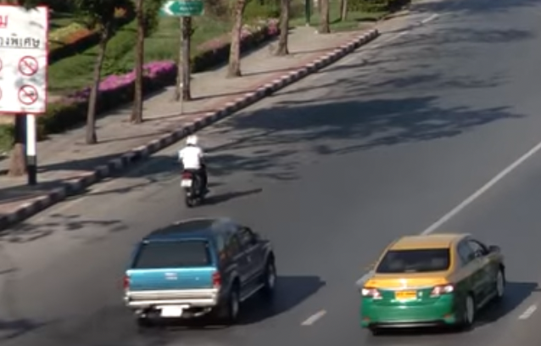
Live videos from cheap cameras need to be analyzed
Wild-life camera
Traffic camera
Drone camera
Our goal: support accurate live video analytics for cheap cameras
Notes:
^ Nowadays, more and more videos are generated from cheap cameras. These videos from cheap cameras need to be analyzed
Wild-life camera for animal protection
Traffic camera for traffic monitoring and incident detection
Drone camera for efficient vehicle counting
Our goal is to support accurate live video analytics for cheap cameras.

Slide 3
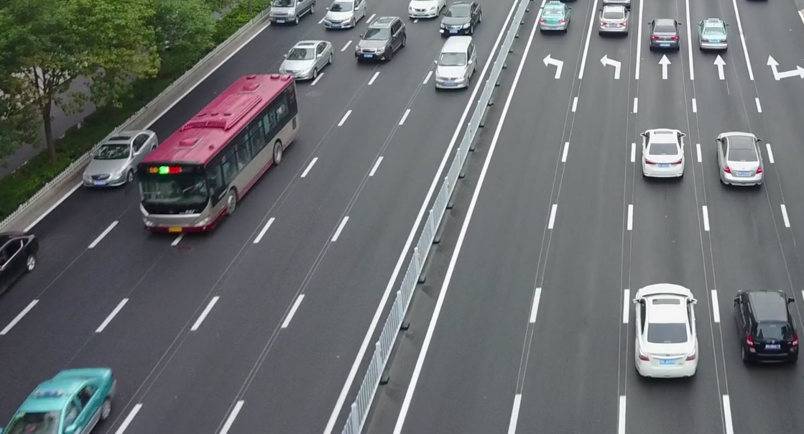
Videos need to be streamed to the server for accurate live video analytics
Analyzed by a cheap
Analyzed by a powerful
camera
GPU-equipped server
detected objects
Low-end object detection
Compute-intensive object detection
Missing a lot of objects, low accuracy
All objects detected, high accuracy
Limited by camera-side compute power, camera-side local inference is inaccurate.
We need to stream the video to the server for accurate analytics.
Notes:
^ First, in live analytics scenario, the video need to be streamed to the server for accurate live video analytics.
$ (Click to next slides)
Stress cheap

Slide 4
Key component for live video analytics: Video compression
Video compression
Raw video, large file size
Compressed video, small file size
Cheap camera
Bandwidth-constrained network
GPU-equipped server
We need to run video compression in order to stream the video out to the server.
Notes:
^ The key to stream the video from the camera to the server is a video compression algorithm.
This is because the network connection between the camera and the server-side DNN is bandwidth constraint.
(Click)
The raw video, if not compressed, cannot be streamed to the GPU-equipped server in real time.
As a result, we need a video compression algorithm to compress the raw video into smaller file size so that the video can be streamed in real time.
To conclude, We need to run video compression in order to stream the video out to the server.

Slide 5
Ideal video compression for live video analytics
Ideal compression
GPU-equipped server
All objects detected
High inference accuracy🎯
Raw video
Pixels related to/not related to detecting objects in high/low encoding quality
Ideally, >80%(DDS,SIGCOMM’20) of the pixels can be compressed without hurting inference accuracy.
Notes:
^ So what is an ideal compression in live video analytics scenario?
Here we show an example. Say the uncompressed raw video is like the left-side image.
$ Given this huge potential, how to design a video compression algorithm for video analytics?
(What is an ideal video compression)

Slide 6
Video compression for video analytics: Three performance objectives.
High inference accuracy
DNN
inference
Uncompressed raw video
Three objects detected
DNN
inference
Compressed video
Still get three objects detected
Notes:
$ To design an idea video compression for video analytics, we specify three system-level performance objectives
Say on the uncompressed video, we get 3 objects detected
If we compress the objects, we still get 3 objects
In other word, accuracy captures the similarity between the inference results of uncompressed raw video and compressed video.

Slide 7
Video compression for video analytics: Three performance objectives.
High inference accuracy
Low end-to-end delay
Encoding delay + streaming delay
Decoding delay & DNN inference
delay
Streaming
delay
Encoding delay
Raw video
Compressed video
Compressed video
Inference results
Bandwidth-constrained network
Cheap camera
GPU-equipped server

Slide 8
Video compression for video analytics: Three performance objectives.
High inference accuracy
Low end-to-end delay
Encoding delay + streaming delay
Low camera-side overhead
Encoding delay should be low even for a cheap camera with only CPU available
Encoding
delay
Raw video
Compressed video
Cheap camera, w/ a CPU that can barely run video codecs
Let us see how previous work performs in terms of these three objectives.

Slide 9
Previous work: Hard to achieve all three performance objectives
High inference accuracy
Server-based compression
e.g., DDS(SIGCOMM’20), Edge(MobiCom’20)
Expensive camera-side heuristics
e.g., run heavy object detection DNN
High camera-side overhead
High end-to-end delay
Low end-to-end delays
Low camera-side overhead
Cheap camera-side heuristics
e.g., Vigil(MobiCom’15), Reducto(SIGCOMM’20)
Low inference accuracy
How to achieve these 3 performance objectives simultaneously?

Slide 10
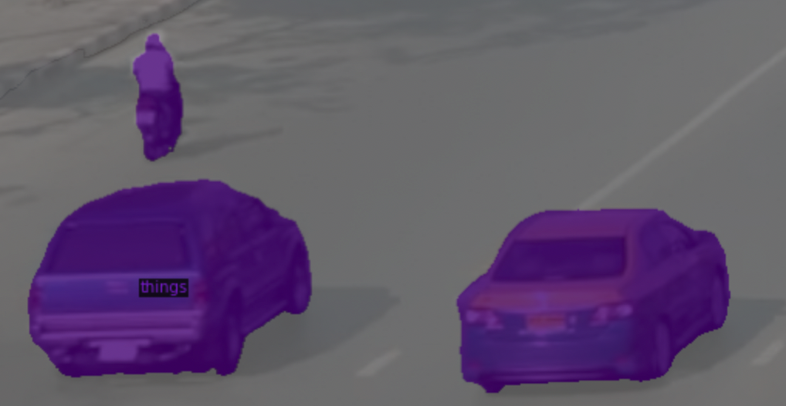
AccMPEG: accurate camera-side video compression for cheap camera
DNN-based encoding quality estimator
Video codec encodes
Raw video
Encoding quality assignment
Brown: High quality (HQ), grey: low quality (LQ)
Compressed video
Cheap camera

Slide 11
What does accurate mean?
The quality estimator should
Put enough areas in HQ to achieve high accuracy
Avoid putting too much areas in HQ (to reduce streaming delay)
DNN-based encoding quality estimator
Video codec encodes
Raw video
Encoding quality assignment
Brown: High quality (HQ), grey: low quality (LQ)
Compressed video
Cheap camera

Slide 12
Requirements for running AccMPEG on cheap cameras
The overhead of getting this assignment should be low (ideally <10ms per frame on CPU)
Fixed overhead
DNN-based encoding quality estimator
Video codec encodes
Raw video
Encoding quality assignment
Brown: High quality, grey: low quality
Compressed video
with one cheap CPU that can barely run video codecs
Cheap camera
Why can we train a quality estimator that can calculate accurate encoding quality assignment with <10ms runtime per frame on CPU?

Slide 13
A strawmen: semantic segmentation
Known to be compute-intensive!
Input video
Visually looks similar
Encoding quality assignment
Brown: High quality (HQ), grey: low quality (LQ)
Semantic segmentation:
Brown: human, purple: car,
grey: background
But the quality assignment is much less compute-intensive than semantic segmentation due to two video codec properties.
Notes:
^ To understand the compute cost of encoding quality assignment, let me pick a strawmen. (click)
We can see that encoding quality assignment is visually similar to a well-studied vision problem: semantic segmentation, (click) which is known to be compute-intensive
However, the quality assignment DNN can be much cheaper than semantic segmentation DNN due to two video codec properties.

Slide 14
Coarser granularity makes the quality assignment DNN less compute-intensive
Video codec assigns one encoding quality for each macroblock (16x16 pixel block)
Assign encoding quality macroblock-by-macroblock instead of pixel-by-pixel
This opportunity has upto ${16}^{2}×$ compute saving potential by allowing the DNN to analyze the video macroblock-by-macroblock instead of pixel-by-pixel.
Notes:
^ First, encoding quality assignment is operating on a coarser granularity, and thus less compute-intensive.
Here is an example to illustrate this reason.
$

Slide 15
Error tolerance makes the quality assignment DNN cheaper
Putting this macroblock in HQ only marginally increases streaming delay
(Video codec compresses this macroblock more efficiently as nearby macroblocks are in high quality)
Even if the DNN wrongfully predict this macroblock in HQ, we can still obtain accurate analytic results with little impact on the streaming delay.
The wrong prediction generated from less compute-intensive DNN may still be tolerable.

Slide 16
Demo: AccMPEG provides huge gain by leveraging video codec properties
(Vigil MobiCom’15)
Right: Cheap camera-side object detector
Left: AccMPEG (Ours)
Detected objects
High-quality area
Blue curve:
AccMPEG (Ours)
Red curve:
Cheap object detector
AccMPEG encodes more small objects in high quality and thus detects more objects.

Slide 17
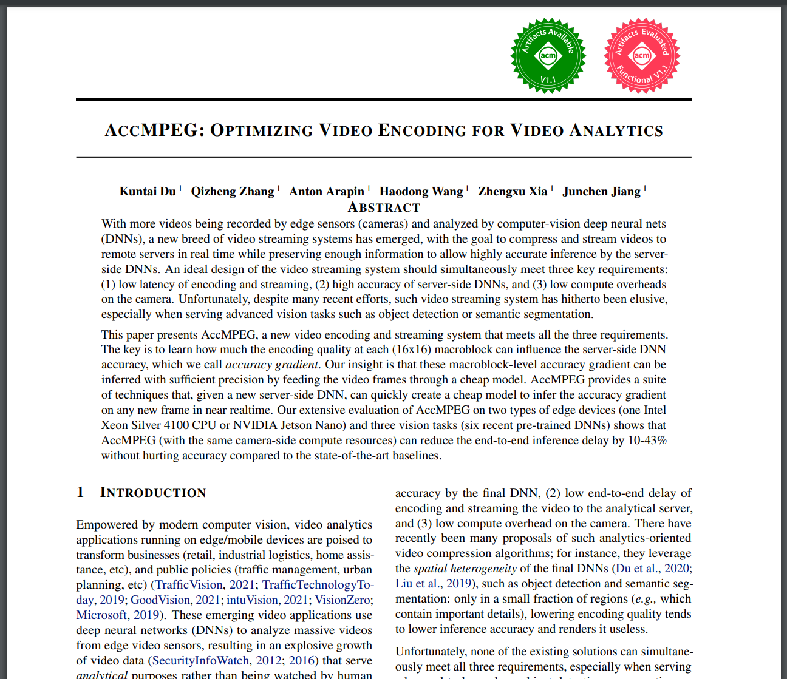
More details in the paper
Reduce the camera-side overhead of running the quality assignment DNN
Cheap quality estimation DNN architecture
Reusing the quality assignment results
Quick training of the quality assignment DNN
Efficient ground truth labeling based on Accuracy Gradient
Data down-sampling to reduce training cost

Slide 18
Experiment setup
Hardware:
Camera hardware: Intel Xeon Silver 4100
We use openVINO to accelerate the camera-side DNN (both our approach and the baselines)
Server hardware: 8 NVIDIA 2080 GPUs.
Dataset: created by keyword search in youtube
We use incognito mode to make the search results unbiased
Network condition
We assume 5 video streams sharing a network link with 2.5Mbps upload bandwidth, with an 100ms network latency

Slide 19
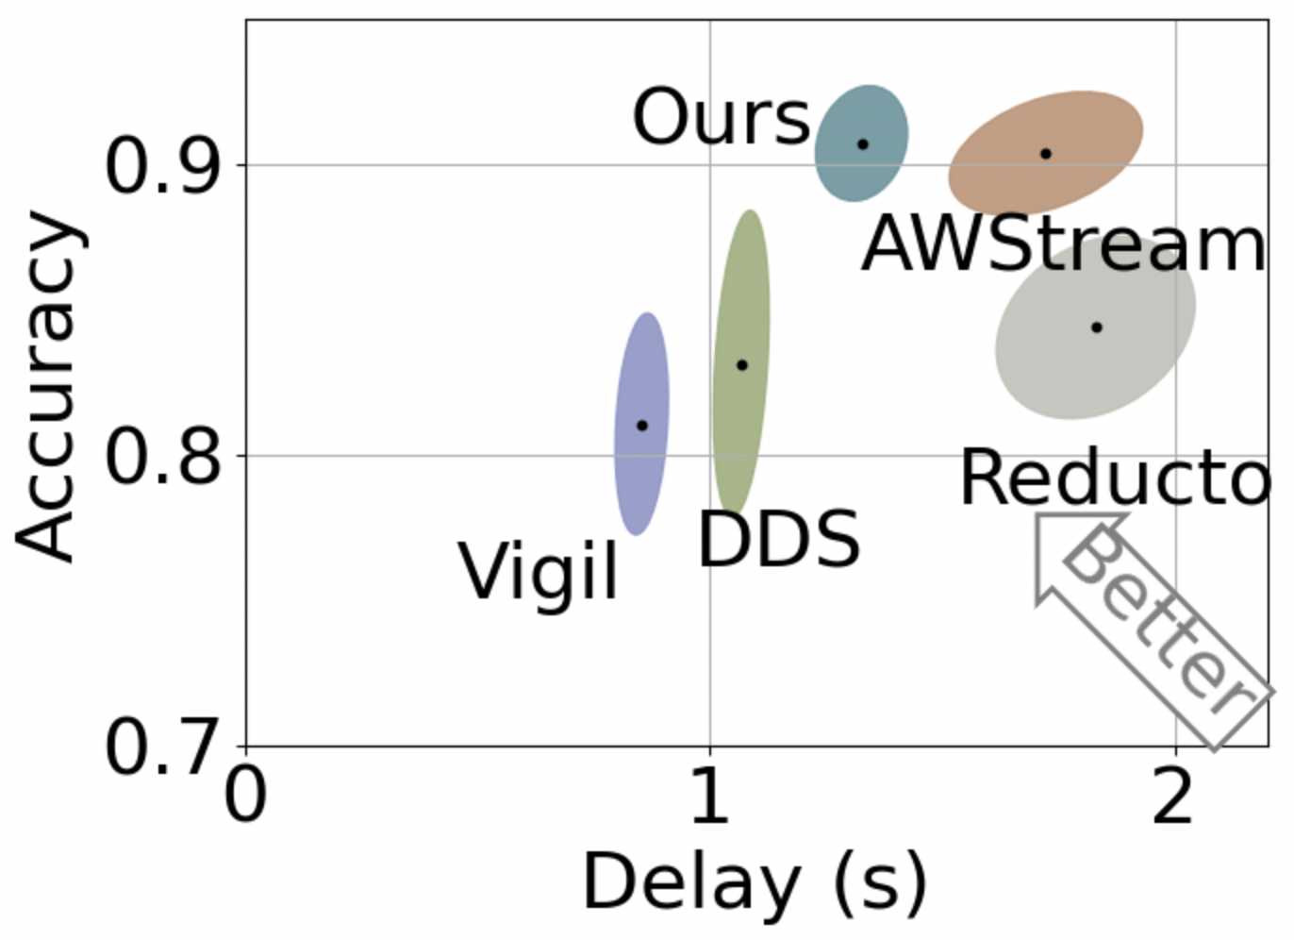
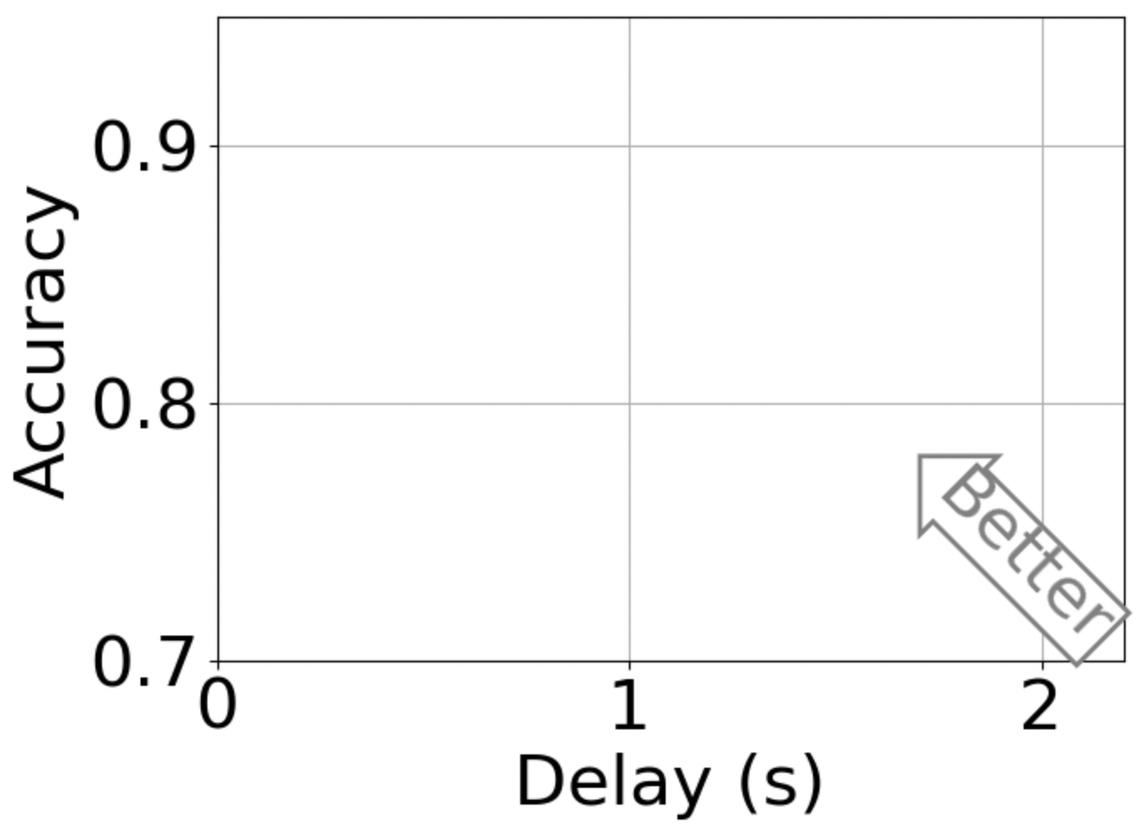
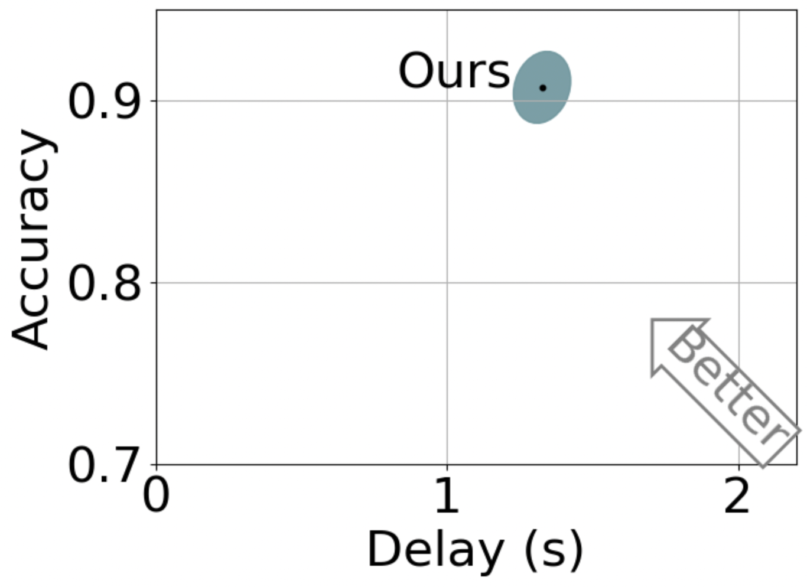
Better delay-accuracy trade-off
AccMPEG (Ours) achieves high accuracy and 10-43% delay reduction than other high-accuracy baselines.
Notes:
X-axis and Y-axis

Slide 20
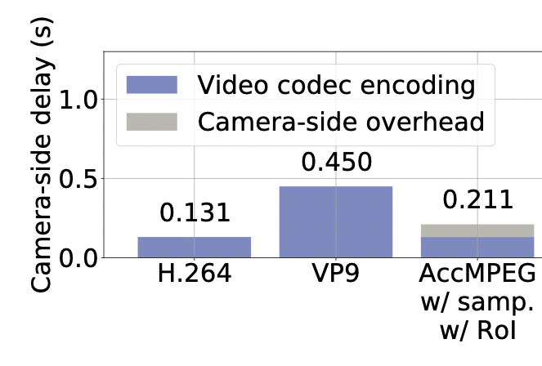
Low camera-side overhead (measured by camera-side delay)
(Two video codecs)
(Ours)
The camera-side overhead of AccMPEG is lower than some video codec.
Notes:
Animate
Add some more results

Slide 21
Conclusion
AccMPEG: Enables accurate video compression for cheap cameras
1. High analytic accuracy with 10-43% delay reduction than the baselines
2. On CPU, the camera-side overhead is even cheaper than an expensive video codec.
My homepage

Slide 22
Model training time
Training dataset: the same with the server-side DNN model
Training approach | Training time
Conventional training | ~8 hours
AccMPEG (ours) training | ~8 minutes
Our training optimization saves ~60x training time. The model can be trained within 8 minutes on an 8-GPU server.

