Slide 1
AccMPEG: Optimizing Video Encoding for Accurate Video Analytics
Kuntai Du
Mar. 8, 2022
Notes:
This talk is about my accepted work in this year’s MLSys. The topic is about optimizing the video encoding for accurate video analytics. After this talk, you will learn about a cheap yet efficient video compressor for video analytics

Slide 2
Live video analytics are pervasive
Wild-life camera
Traffic camera
Drone camera
Notes:
^ Nowadays, live video analytics are pervasive in our life.
Wild-life camera for animal protection
Traffic camera for traffic monitoring and incident detection
Drone camera for efficient vehicle counting

Slide 3
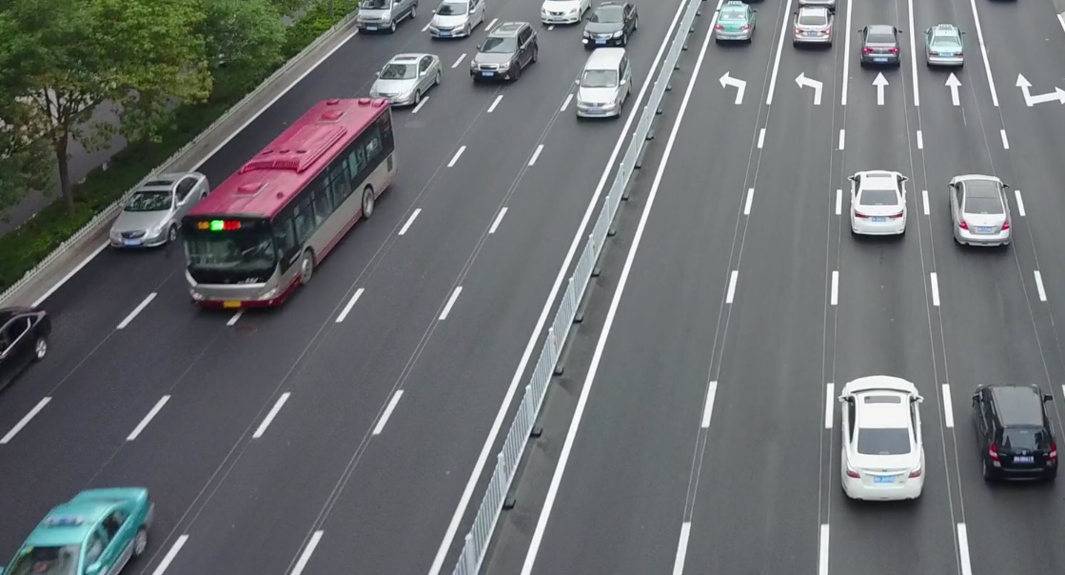
Video need to be streamed to the server for accurate live video analytics
Analyzed by camera locally
Analyzed by a GPU-equipped server
missed objects
detected objects
Cheap model output
(SSD-MobileNet-v2)
Expensive model output
(FasterRCNN-ResNet101)
Limited by camera-side compute power, the camera-side local inference is inaccurate.
We need to stream the video to the server for accurate analytics.
Notes:
^ In live analytics scenario, the video need to be streamed to the server for accurate analytics.
Note that this is a bit uncommon requirement that is pretty unique to live video analytics. In some other settings, like video analytic database for example, the videos are already at the server and ready for analytics.
So we don’t need to stream the video to the server cuz it’s already there.
Let me explain why we need to stream the video to the server in our case.
(Start to look at the figure)
$ (Click to next slides)

Slide 4
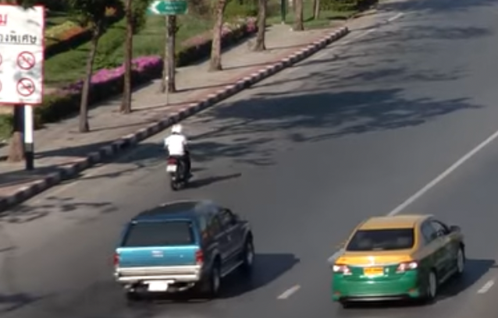
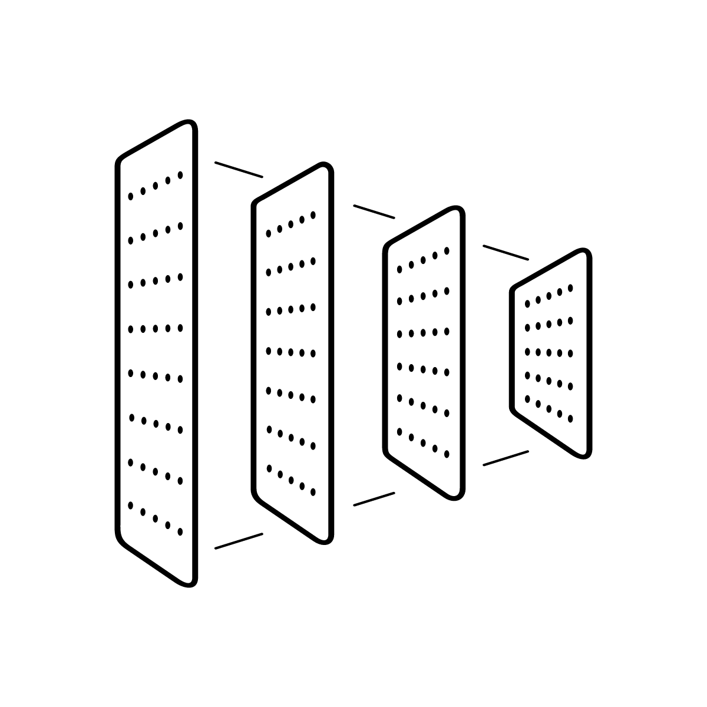
Key component for live video analytics: video compression
The bandwidth is not enough to stream uncompressed video in real time
Uncompressed video
Camera
Bandwidth-constrained network
Server-side DNN
We need to compress the video and then stream the video out to the server.
-- Just use video codec to compress the video!
-- That’s not ideal, let me explain why
Notes:
^ Now that we need to stream the video to the server, the key component for live video analytics is therefore a video compression algorithm. This is because the network connection between the camera and the server-side DNN is typically bandwidth-constrained and cannot afford to stream the uncompressed video.

Slide 5
Video compression for video analytics cares about inference accuracy
Video compression for human viewers
(video codec)
Video compression for video analytics
Visual quality
Inference
accuracy
Human viewer
Server-side deep
neural network (DNN)
Blurry image,
low visual quality😠
All objects detected,
high inference accuracy✅
Notes:
^ It is because traditional video codecs care about the **visual quality,** but video compression for video analytics cares about **inference accuracy**.
$ You may wonder, OK I know that they care about different metrics, but why does that difference matter?

Slide 6
Inference accuracy allows aggressive video compression
Inference
accuracy
Server-side DNN
All pixels in high encoding quality.
<20% pixels[1] in high encoding quality.
All objects detected,
accuracy=100%
All objects detected,
accuracy=100%
[1] Server-Driven Video Streaming for Deep Learning Inference, Du, Kuntai* and Pervaiz, Ahsan* and Yuan, Xin and Chowdhery, Aakanksha and Zhang, Qizheng and Hoffmann, Henry and Jiang, Junchen, SIGCOMM 2020
>80% of the pixel can be compressed without hurting inference accuracy.
Notes:
^ It matters a lot because inference accuracy allows us to compress the video **very aggressively**
$ Given such a high potential for improvement, let’s **design** an **ideal** video compression that can fully realize this potential.

Slide 7
Design an ideal video compression for video analytics: Three performance objectives.
DNN
inference
High inference accuracy
Uncompressed video
Inference results
DNN
inference
Compressed video
Similar to the inference results on uncompressed video
Camera
Bandwidth-constrained network
Server-side DNN
Notes:
$ To design an idea video compression for video analytics, we find three system-level performance objectives is really crucial

Slide 8
Design an ideal video compression for video analytics: Three performance objectives.
High inference accuracy
Low end-to-end latency
Encoding delay + streaming delay
Low camera-side overhead
Encoding delay should be low even for a CPU-only camera
Encoding
delay
Streaming
delay
Decoding & DNN inference
Raw video
Compressed video
Compressed video
Inference results
Camera
Bandwidth-constrained network
Server-side DNN
However, none of the previous work achieves all three performance objectives!
Notes:
$ However, we found that **none** of the previous work achieves all of the system-level objectives simultaneously! Why is it so difficult? (Pause)

Slide 9
Functionality placement: Where should we determine how the video should be compressed?
Ideal video compression requires the knowledge of both the video content and the DNN.
Video content
DNN
Camera
Bandwidth-constrained network
Server
How previous work places this functionality?
Notes:
The difficulty behind this ideal video compression is a functionality placement problem. Concretely, it’s really hard to decide **where** should we determine how the video should be compressed.
^ If we compress the video by the camera, we need to guess what the server-side DNN need with such limited compute on the camera. If we ask for the server’s help, we need to go through the bandwidth-constrained network multiple times to talk to the server. Ah, it’s really difficult to choose. Let’s see some example designs from previous work.

Slide 10
Previous work type 1: Use cheap camera-side heuristics to decide how to compress the video
Cheap
heuristics
Decode
& inference
Network
Video content
Inference results
One person is not detected,
low accuracy
Compressed video
Cheap heuristics does not have enough compute to identify small objects, like the human in the red box
Camera
Server
Cheap camera-side heuristics ➔ low accuracy.
Notes:
^ The first type of previous work uses cheap camera-side heuristics to decide how to compress the video
$ Huh, cheap camera-side heuristics suffer from low accuracy. Then **maybe** we can improve the accuracy by using **expensive** heuristics.

Slide 11
Previous work type 2: Use expensive camera-side heuristics to decide how to compress the video
High camera-side overhead
Expensive
heuristics
Decode
& inference
Network
Video content
Compressed video
Inference results
All object detected, high accuracy
Camera
Server
Expensive camera-side heuristics ➔ high camera-side overhead.
Notes:
^ This leads us to a second type of previous work that uses expensive camera-side heuristics instead to decide how to compress the video
$ Looks like camera-side heuristics it just doesn’t work. What about asking for server’s help?

Slide 12
Previous work type 3: Use server to decide how to compress the video
Network
Camera
Server
Timeline
Timeline
Low-quality video
Need to send each frame twice
➔ High delay
DNN analyzes
the video
Regions that require high encoding quality
DNN
inference
High accuracy
Re-send these regions in high quality
Server-driven video compression ➔ high delay
Notes:
^ This leads us to the third type of work: use server-side compute to decide how to compress the video. To better visualize the communication between the camera and the server, we draw a timeline figure here.
$ Now let’s summarize the previous work.

Slide 13
Summary of previous video compression: Hard to achieve all three performance objectives
High inference accuracy
Expensive camera-side heuristics
Server-based compression
High camera-side overhead
High end-to-end delay
Low end-to-end delays
Low camera-side overhead
Cheap camera-side heuristics
Low inference accuracy
How to achieve these 3 performance objectives simultaneously?
Notes:
^ To summarize, it is hard for previous work to achieve three performance objectives.
$ So how should we achieve these three requirements simultaneously? (Pause)

Slide 14
AccMPEG: Neal-ideal camera-side video compression
Cheap quality
selector
Pick the regions with high quality estimation
Encode and stream to the server
Accuracy Gradient estimation
Quality assignment
Brown: High quality, grey: low quality
Input video
Accuracy Gradient measures how much will the accuracy change if we change the pixel value a little bit.
Camera
What? Why is this near-ideal?
Notes:
^ We present our approach: AccMPEG, which is a near-ideal camera-side video compression algorithm.
$ You may ask wait what? Why do you claim such a simple pipeline near-ideal? You said your cheap camera-side heuristics doesn’t work right?

Slide 15
AccMPEG satisfies three performance objectives.
Guarantee low encoding delay and low camera-side overhead
Cheap quality
selector
Pick the regions with high Accuracy Gradient
Quality assignment
Brown: High quality, grey: low quality
Input video
Accuracy Gradient Estimation
Guarantee low streaming delay and high accuracy
if the estimation is good.
This is mathematically provable under certain assumptions.
Why can such a cheap quality selector learn such a powerful Accuracy Gradient?
Notes:
^ Let me explain why. Though the pipeline looks simple, our design AccMPEG does satisfy three performance objectives.
$ So if the cheap quality selector model can estimate Accuracy Gradient pretty well, we can achieve all three performance objectives.
But why? Why can such a cheap quality selector learn such a powerful Accuracy Gradient?

Slide 16
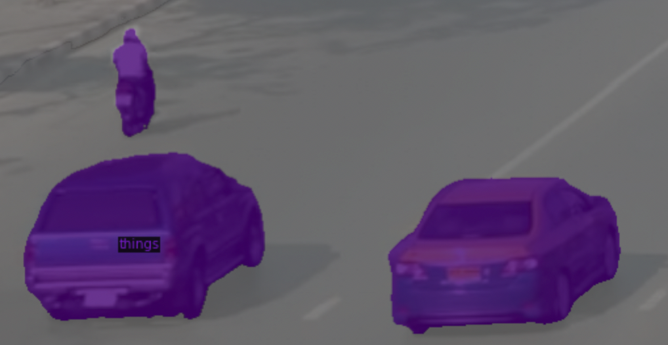
Why could the quality selector be cheap? An analogy between quality assignment and semantic segmentation
Input video
Functionally similar
Quality assignment
Brown: High quality, grey: low quality
Semantic segmentation:
Brown: human, purple: car,
grey: background
But the quality assignment is much cheaper than semantic segmentation due to three reasons.
Notes:
^ To think about this, let me make an anology. Functionally quality assignment is just like semantic segmentation. Here is an example.
$ Semantic segmentation is known to be pretty expensive. It typically takes hundreds of layers and millions of parameters to do segmentation well. But actually, the quality assignment is MUCH CHEAPER than semantic segmentation due to three reasons.

Slide 17
Coarser granularity makes the quality assignment potentially cheaper
Quality assignment:
One label per macroblock (16x16 pixel block)
Semantic segmentation: one label per pixel
This enables the quality selector to scan the video macroblock-by-macroblock instead of pixel-by-pixel. This opportunity has upto ${16}^{2}×$ compute saving potential.
Notes:
^ First, quality assignment problem is operating at a coarser granularity than semantic segmentation, which makes the quality assignment cheaper.
Let’s see a concrete example
$

Slide 18
Binary segmentation makes the quality assignment potentially cheaper
Quality assignment:
HQ or LQ
Binary segmentation
Semantic segmentation:
Car? Human? Background?
Multi-class segmentation
Quality assignment (binary segmentation) is much cheaper than semantic segmentation (multi-class segmentation).
Notes:
^ The second reason is that quality assignment is a binary segmentation problem, thus much cheaper than multi-class segmentation problem like semantic segmentation.
Here is a visualization on this.
$

Slide 19
Error tolerance makes the quality assignment potentially cheaper
Quality selection: Putting this macroblock in HQ only marginally increases streaming delay and still achieves high accuracy.
(Codec’s compression is more efficient
when more macroblocks are in high quality)
Semantic segmentation:
Labelling this macroblock to human reduces human segmentation accuracy from 100% to <50%
Quality selection is less sensitive to errors compared to semantic segmentation, which makes quality selection potentially cheaper.
Notes:
^ Third, quality assignment has a much higher error tolerance than semantic segmentation, which means that a cheap model that is not that good for semantic segmentation is already good enough for quality assignment.
$ Hope that now you see why the quality selector can be so cheap. Now let me show how to actually get such a cheap quality selector
(Pause)

Slide 20
Implement a cheap quality selector: Architecture
A cheap feature extractor with high energy efficiency, wildly deployed on mobile devices
MobileNet SSD feature extractor
Three convolutions + softmax
Input video
Features
Output
Our model: 12 GFLOPs, 3x cheaper than a cheap 18-layer neural network (ResNet18)
Notes:
$ We first use a cheap model architecture for a quality selector
^ To conclude, the compute cost of our model is only 12 GFLOPS, 3x cheaper than a cheap 18-layer neural network (ResNet18). We then train the quality selector based on the server-side DNN.

Slide 21
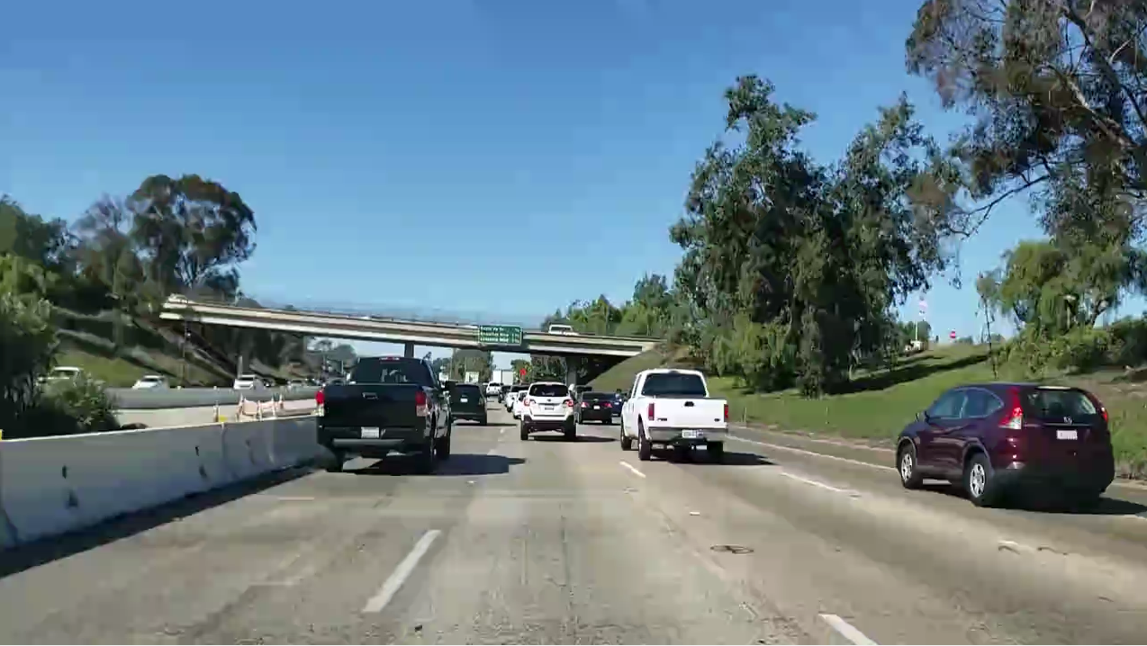
Train the quality selector: A conventional way
Need to run server-side DNN in every training loop.
Too expensive.
Conventional training
Training iteration
Assign
quality
Accuracy
Selector
server-side DNN Inference
Input images
Quality assignment
Encoded images
Is it possible to train the quality selector without running the expensive DNN?
Notes:
$ Let’s see a conventional wisdom of training a quality selector. This is a way that is wildly-adopted by computer vision community.
^ Overall, the training time may take several hours.
Is it possible to train the quality selector without running server-side DNN? (Pause)

Slide 22
Train the quality selector cheaply through Accuracy Gradient
Ours training
Only need to run server-side DNN to calculate Accuracy Gradient before training loop starts.
Much cheaper.
Training iteration
Similarity against Accuracy Gradient
Selector
Input images
Quality assignment
Notes:
$ The answer is to use Accuracy Gradient as the ground truth label to train the quality selector.
^ After this optimization, the training time can be reduced to about one hour. I’d say it is still a big long. Is it possible to further reduce this training overhead?

Slide 23
Further speed-up the training
Training set: the same with the server-side DNN with 10x downsampling
The quality selector is cheaper and contain much less parameters. So 10x less training data are already enough to train a model of good quality.
Notes:
^ we can further speed up the training by doing dataset downsampling.
$ This is the last slides before the experiment result. Is there anything unclear? If not, I’ll introduce the experiment results.

Slide 24
Experiment setup
Hardware:
Camera hardware: CPU with openVINO acceleration available (we use Intel Xeon Silver 4100)
We use openVINO to accelerate our quality selector model and the baselines.
Server hardware: 8 NVIDIA 2080 GPUs.
Dataset: we search a keyword in youtube and download the top videos
Network condition
We assume 5 video streams sharing a network link with 2.5Mbps upload bandwidth, with an 100ms latency

Slide 25
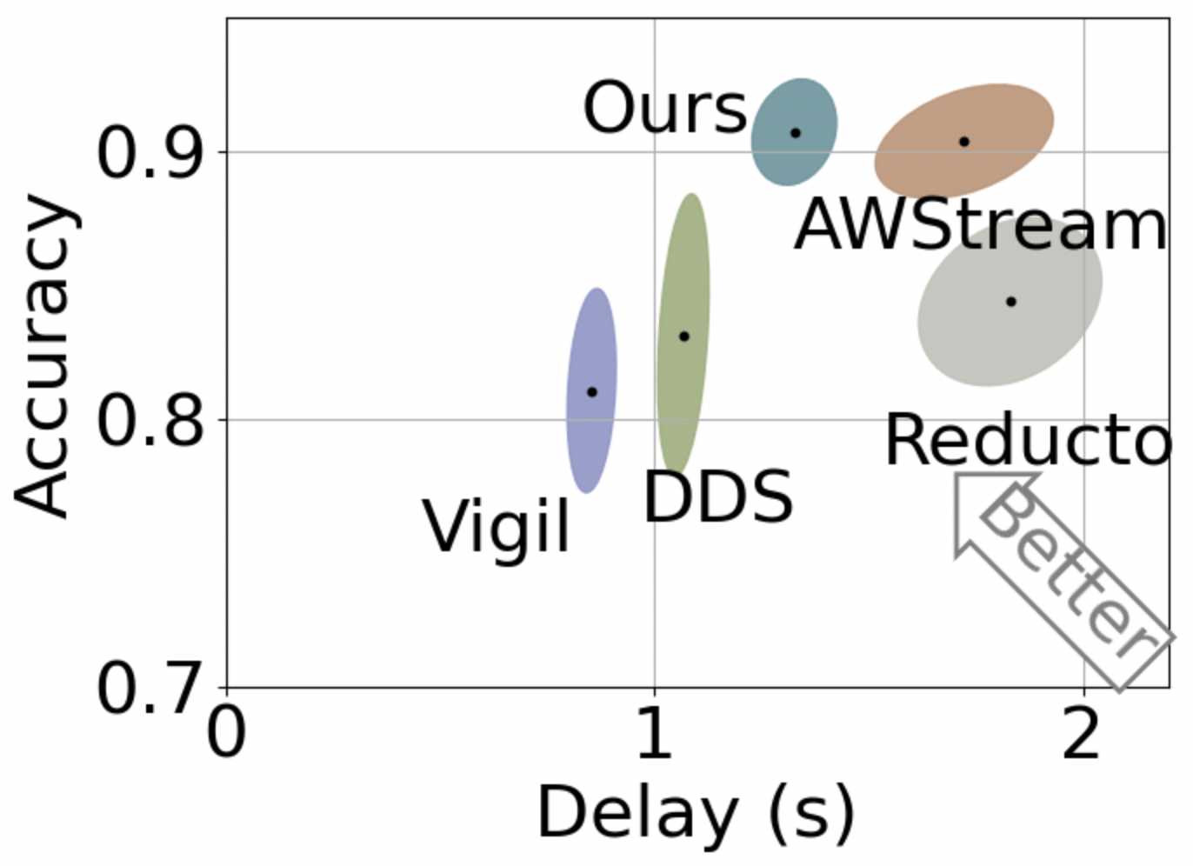
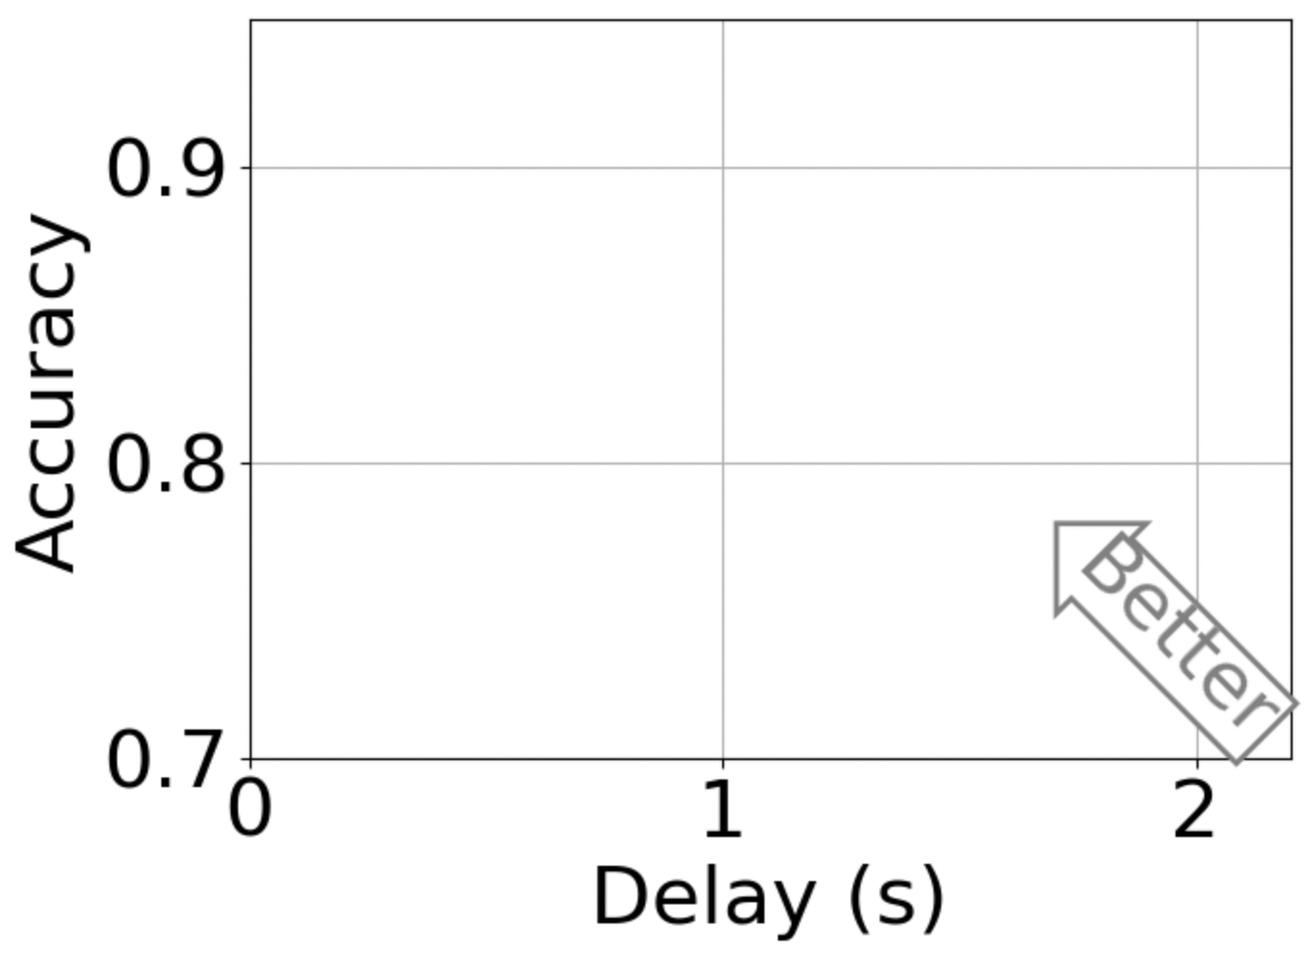
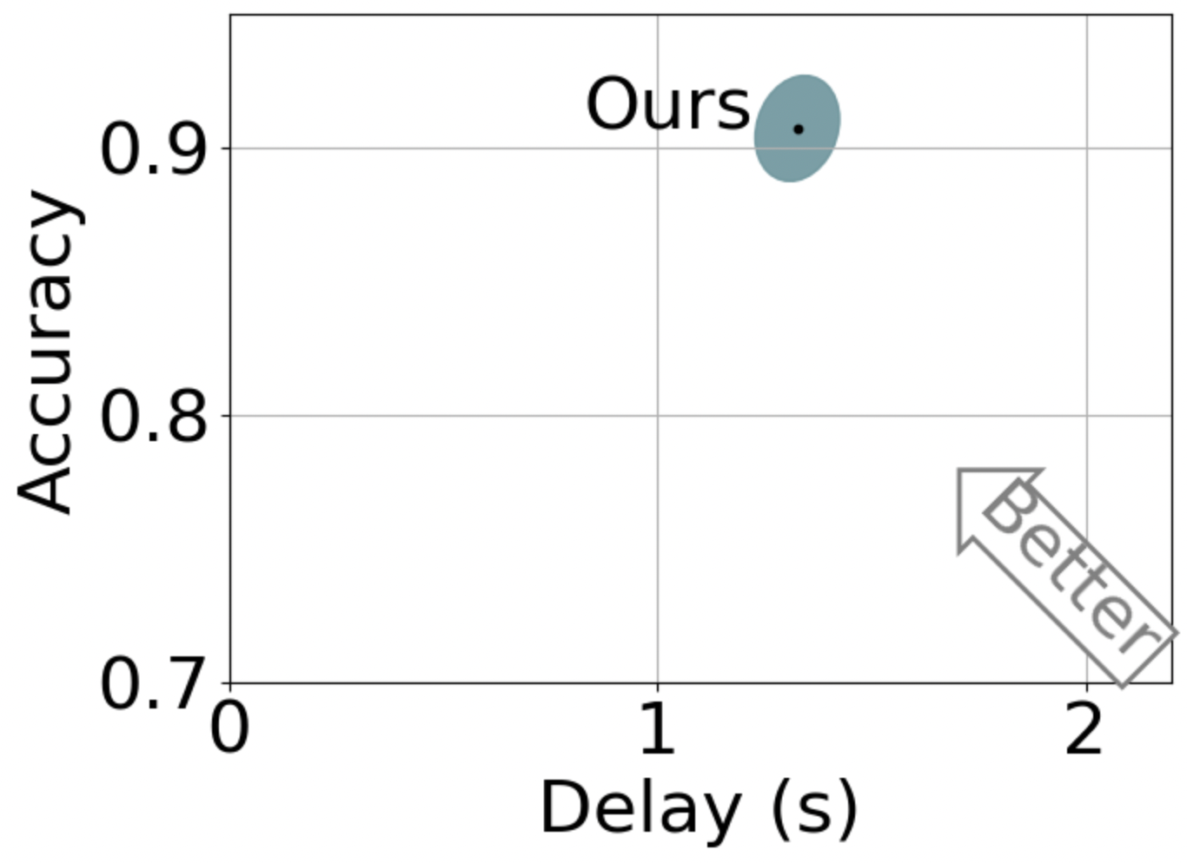
Better delay-accuracy trade-off
Our approach achieves high accuracy with 10-49% delay reduction.

Slide 26
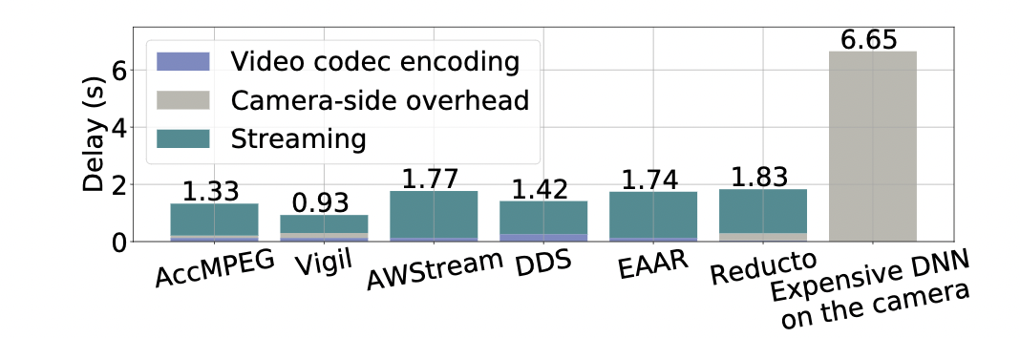
End-to-end delay
(Ours)
Delay breakdown on camera-side CPU
Though Vigil has lower streaming delay than our approach, the accuracy of Vigil is consistently much lower (10%-20%).
Our approach achieves high accuracy with lowest end-to-end delay.

Slide 27
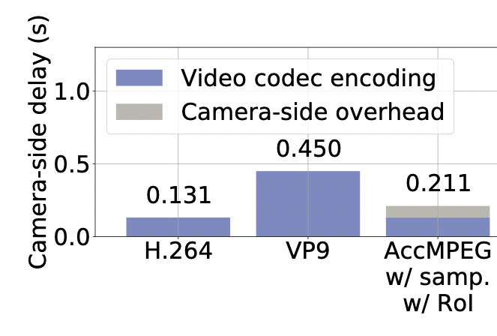
Camera-side overhead
We measure camera-side overhead by camera-side delay
(Two video codecs)
(Ours)
The camera-side overhead of our approach is even lower than a slightly more expensive video codec.

Slide 28
Model training time
Training dataset: the same with the server-side DNN model
Training approach | Training time
Conventional training | ~8 hours
AccMPEG (ours) training | ~1 hours
AccMPEG (ours) training w/ 10x dataset downsampling | ~8 minutes
Our training optimization saves ~60x training time. The model can be trained within 8 minutes on an 8-GPU server.

Slide 29
Future work
Encode the video with multiple quality level
Background: Low quality
Easy-to-detect objects (e.g., large objects): Medium quality
Hard-to-detect objects (e.g., small objects): High quality
Train a model to compress the video temporally
If we know some frames have highly similar inference results, we only need to encode one of them.

Slide 30
Conclusion
Our approach: achieve high accuracy, low end-to-end delay and low camera-side overhead simultaneously
Key enabler: Accuracy Gradient that describes how much the inference accuracy will change if we change the pixel value for a little bit
Performance
1. Highest accuracy with 10-49% delay reduction than the baselines
2. Our camera-side overhead is even cheaper than some video codecs.
3. Our model can be trained within 8 minutes.
[1] Server-Driven Video Streaming for Deep Learning Inference, Du, Kuntai* and Pervaiz, Ahsan* and Yuan, Xin and Chowdhery, Aakanksha and Zhang, Qizheng and Hoffmann, Henry and Jiang, Junchen, SIGCOMM 2020
[2] AccMPEG: Optimizing Video Encoding for Accurate Video Analytics, Du, Kuntai and Zhang, Qizheng and Arapin, Anton and Wang, Haodong and Xia, Zhengxu and Jiang, Junchen, MLSys 2022

Slide 31
Backup slides

Slide 32
Does the AccMPEG trained for one DNN generalize to another DNN?
(With the same training set)

Slide 33
Does the AccMPEG trained for one DNN generalize to another DNN?
(Ours)
(Video codec)
(With the same training set)

Slide 34
Does the AccMPEG trained for one DNN generalize to another DNN?
(Ours)
(Video codec)
Even when the server-side DNN changes silently, our approach still achieves lower delay than not using our approach (as long as the training set does not change).
(With the same training set)

Slide 35
What is an ideal video compression for video analytics?
Input frame
DNN inference results on uncompressed input frame
Ideal compression: just encode enough information to maintain 100% accuracy.
Accuracy: compare against the inference results on uncompressed input frame
What is the performance objective of ideal video compression?
Notes:
$ First, let’s talk about what is an ideal video compression for video analytics
^ Now that we know what is ideal compression, what is the system-level objective of ideal video compression?

Slide 36
Two properties for the quality selector
1. Quality selector
should be cheap
2. Quality assignment should generate near-ideal compression
Encode and stream to the server for anlaytics
Quality selector
Input video
Quality assignment
Brown: High quality, grey: low quality
Camera
Notes:
$ We introduce two properties for the quality selector.
^ With these two properties, we can achieve all three system-level performance objectives.

Slide 37
With these two properties, we can achieve all three performance objectives.
2. Quality assignment should generate near-ideal compression
Reduces camera-side overhead
and encoding delay
1. Quality selector
should be cheap
Reduces streaming delay
while maintaining high accuracy
Encode and stream to the server for anlaytics
Quality selector
Input video
Quality assignment
Brown: High quality, grey: low quality
Camera
How to realize these two properties?
Notes:
$ Let me explain why is that.
^ OK, now we know that these two properties can help us hit three performance objectives, how should we realize these properties?

Slide 38
How to generate near-ideal compression? Train quality selector through Accuracy Gradient!
Accuracy gradient: measure the accuracy impact of encoding a macroblock in high quality (HQ)
Sum over a macroblock to get the accuracy gradient for that macroblock.
Higher the accuracy gradient ➔ higher the encoding quality should be.
Accuracy Gradient
$$=$$
$$abs($$
$$abs($$
$$)$$
$$−$$
$$)$$
$$×$$
HQ
LQ
How much the value change on each pixel affects inference accuracy
Why does Accuracy Gradient enable near-ideal compression?
Notes:
^ Our answer is to achieve near-ideal compression by training the quality selector through Accuracy Gradient. Let’s define Accuracy Gradient first.
$ Now we know the definition of Accuracy Gradient. But why is it so good that enables near-ideal compression?

Slide 39
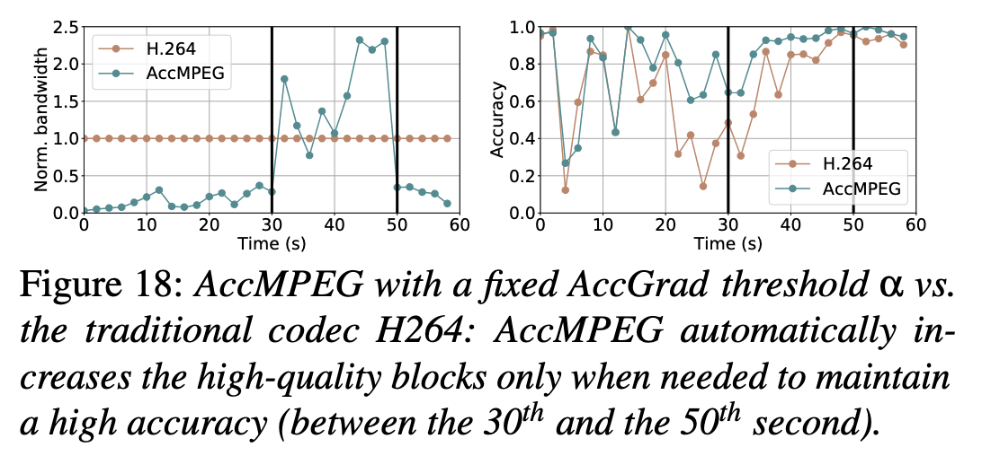
How to determine which regions should be encoded in high quality based on the Accuracy Gradient Estimation?
1. Constant threshold
Good for maintaining high accuracy. But the bandwidth will fluctuate more
2. Constant percentage of high quality areas.

